Slide 1


UNIVERSIDAD AUTÓNOMA DEL ESTADO DE HIDALGO
ESCUELA SUPERIOR DE ZIMAPÁN
Licenciatura en Derecho
Conversaciones introductorias. Lengua extranjera.
L.E.L.I. Paulina Trujillo Castillo
Enero – Junio 2016

Slide 2
Resumen (abstract):
Ésta presentación muestra algunas formas posibles para compartir información personal acerca de uno mismo y de otros.
(This presentation shows some possible forms to share personal information about ourselves and other people.)
Palabras claves en idioma (keywords):
Am, is, are, what, how old, where, when.

Slide 3
Objetivo general:
El egresado será capaz de comprender las ideas principales de un discurso oral o escrito acerca de asuntos cotidianos siempre y cuando estos sean expresados de manera simple y clara, para poder relacionarse en su ámbito inmediato de igual manera podrá realizar descripciones básicas de interés personal.

Slide 4
Nombre de la unidad:
1. Saludos, presentaciones e intercambio de información personal.
Objetivo de la unidad:
Entender y proporcionar información personal simple de manera escrita y verbal con el fin de poder plantear y contestar preguntas fácticas de sí mismo y de otras personas en contextos donde se requiera información personal.

Slide 5
Tema:
1.3 Intercambio de información personal de manera verbal y escrita.
Introducción:
To introduce people we can use the verb to be to give and ask for personal information about ourselves and other people.

Slide 6
Desarrollo del tema:
We can use the verb to be to ask for and give personal information such as: name, age, origin, marital status, address, phone number, email address, and so on.

Slide 7

Examples:

Slide 8


Slide 9
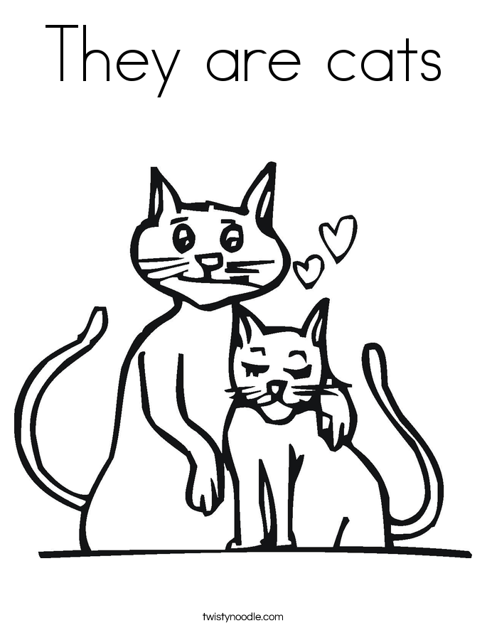

Slide 10
Form
The verb to be has three forms: am, is and are. And we use them with different subjects. Look at the following information to notice that:
Affirmative form
I You He She It We You They | am/ ‘m are/ ‘re is/ ‘s is/ ‘s is/ ‘s are/ ‘re are/ ‘re are/ ‘re

Slide 11
Negative form
I You He She It We You They | am not/ ‘m not are not/ aren’t is not/ isn’t is not/ isn’t is not/ isn’t are not/ aren’t are not/ aren’t are not/ aren’t

Slide 12
Interrogative form
Am Are Is Is Is Are Are Are | I? you? he? she? it? we? you? they?

Slide 13

Sharing personal information
Personal information questions are the basis for any conversation in English and so are important for when you meet somebody for the first time. Here you can see some examples about this:

Slide 14
Names What is your name? My name is _______. What is your surname / last name? My surname / last name is _______. Work & Occupation What do you do? I am a _______. Marital Status Are you married / single? Yes, I am. or No I'm not. What is your partner's name? My partner's name is _______. | Family My parents’ names are _____________. She is my sister __________________. They are my cousins. Age How old are you? I am _______ years old. When is your birthday? My birthday is on the _______ of _______. Contact Information Where are you from? I am from _______. What is your address? My address is _______.

Slide 15
Contact information What is your phone number? My phone number is _______. What is your cell phone number? My cell phone number is _______. What is your e-mail address? My e-mail address is _______. Free time activities What are your hobbies? My hobbies are _______. My favourite singer / group is _______. Habits One of my bad habits is _______.

Slide 16
Conclusions:
The verb to be is useful when we want to share personal information with other people.
It can be used to say “ser” or “estar” in spanish, so that is why it a very used verb.

Slide 17
Bibliografía sugerida para el tema:
Paul Davies, M. G. (2014). Make it real! Professional. Pachuca: UAEH University Press.
Redston, C. Cunningham, G. (2005). Face2Face Elementary Student’s Book. Cambridge, London. Cambridge University Press.

